Slide 1
물리화학적 특징의 귀납적 방식을 통한 마약 물질 분류

Slide 2
Narcotic drugs(마약)
마약류(drugs)란 일반적으로 느낌, 생각 또는 행태에 변화를 줄 목적으로 섭취하는 정신에 영향을 주는 물질(psychoactive substance)를 말한다.

Slide 3
분류
효능에 의한 분류
억제제 : 중추 신경계의 기능을 저하
각성제 : 중추 신경계의 활동을 강화
환각제 : 감각의 왜곡
2. 법률에 의한 분류
But 화학적 특성에 대한 마약성 물질의 원천적 구별은 불가능

Slide 4
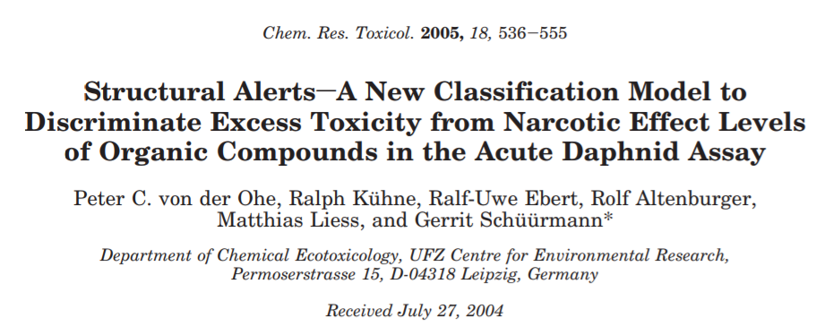

Slide 5
Abstract
Quantitative and qualitative structure-activity relationships (QSARs) have a great potential to support the risk assessment of chemicals, provided there are tools available that allow evaluation of the suitability of QSARs for the compounds of interest. In this context, a pragmatic approach is to discriminate excess toxicity from narcotic effect levels, because the latter can be estimated from QSARs and thus have a low priority for experimental testing. To develop a respective scheme for the acute daphnid toxicity as one of the primary ecotoxicological endpoints, 1067 acute toxicity data entries for 380 chemicals involving the daphnid species Daphnia magna were taken from the on-line literature, and quality checks such as water solubility were employed to eliminate apparently odd data entries. For 36 known narcotics with LC50 values referring to D. magna, a reference baseline QSAR is derived. Compounds with LC50 values above a certain threshold defined relative to their predicted baseline toxicity are classified as exerting excess toxicity. Three simple discrimination schemes are presented that enable the identification of excess toxicity from structural alerts based on the presence or absence of certain heteroatoms and their chemical functionality. Moreover, a two-step classification approach is introduced that enables a prioritization of organic compounds with respect to their need for experimental testing. The discussion includes reaction mechanisms that may explain the association of structural alerts with excess toxicity, a comparison with predictions derived from mode of action-based classification schemes, and a statistical analysis of the discrimination performance in terms of detailed contingency table statistics.

Slide 6
What does LC₅₀ mean?
LC stands for "Lethal Concentration". LC values usually refer to the concentration of a chemical in air but in environmental studies it can also mean the concentration of a chemical in water.
According to the (Organisation for Economic Cooperation and Development) (OECD) Guidelines for the Testing of Chemicals, a traditional experiment involves groups of animals exposed to a concentration (or series of concentrations) for a set period of time (usually 4 hours). The animals are clinically observed for up to 14 days.
The concentrations of the chemical in air that kills 50% of the test animals during the observation period is the LC₅₀ value. Other durations of exposure (versus the traditional 4 hours) may apply depending on specific laws.

